Slide 1
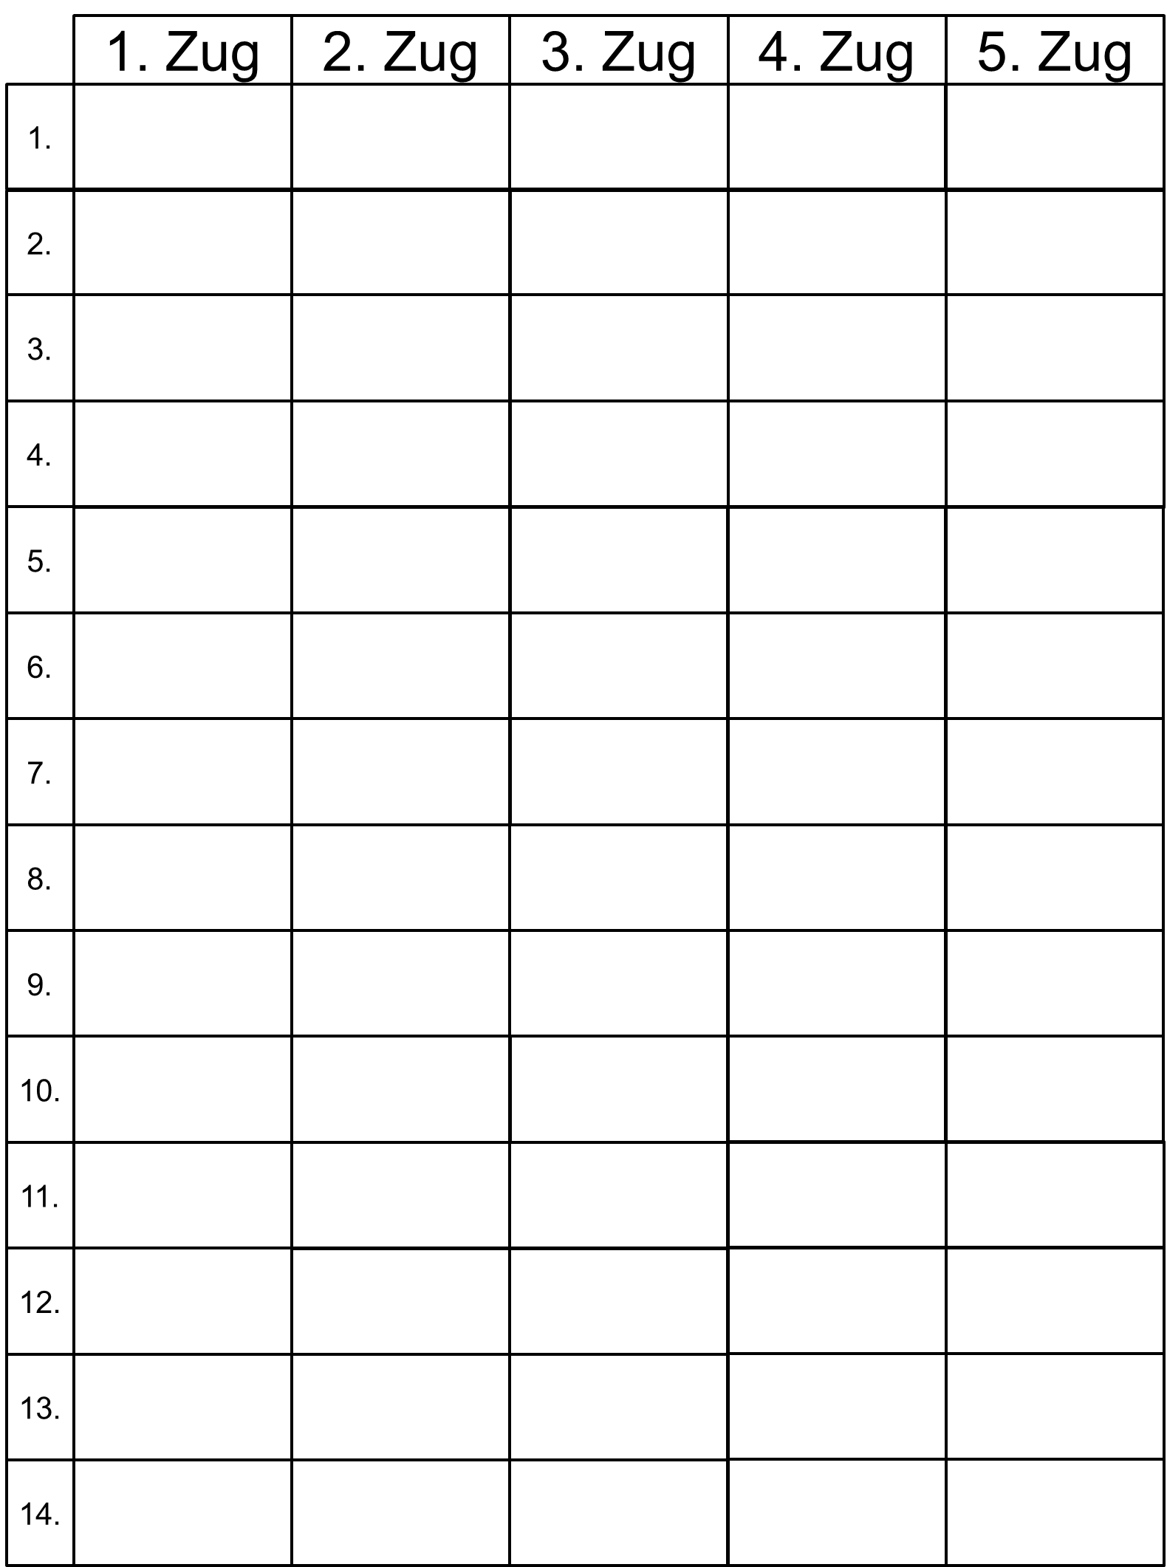
S
980
965
935
970
951

Slide 2
S
Summe
Summe
Summe
Summe
Summe

